Slide 1
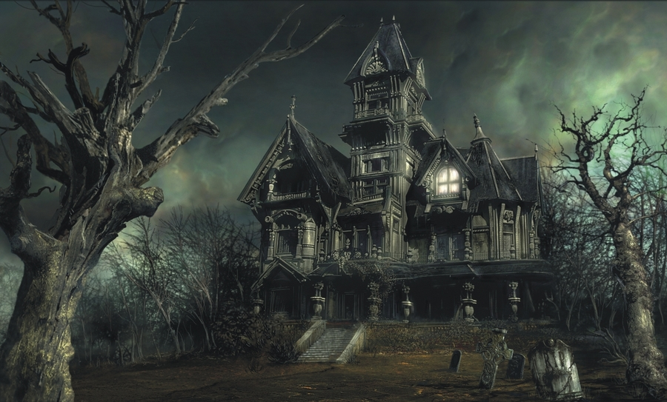
PYTHON HAUNTED HOUSE

Slide 2
SETUP
Create 3 python files
Main.py
Items.py
Room.py

Slide 3
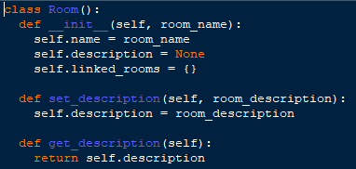
Room.py
ATTRIBUTES
Default attributes of the class
SETTER
GETTERS & SETTERS
Create a getter and setter for the name of the room
GETTER

Slide 4

Main.py
REMEMBER:
object names cannot have spaces
CREATING AN OBJECT
Create a Ballroom and a Dining Hall in the same way as the kitchen.

Slide 5

Room.py
This will allow us to view the description in the main programme.
Why did we add an additional method and not just use the get_description method?

Slide 6
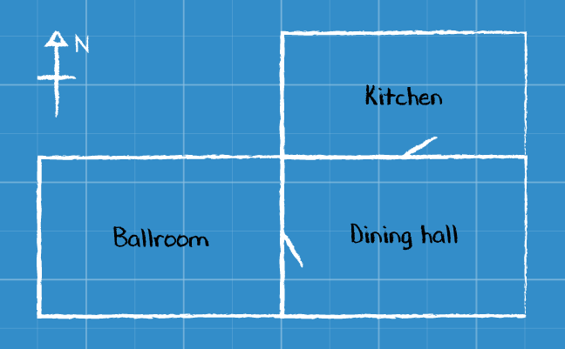
Map

Slide 7
Room.py
Linking Rooms Using DICTIONARIES
Create a Room Linking Method

Slide 8
Main.py
Create navigation to the Dining Hall and the Ballroom

Slide 9
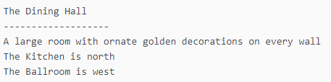
Room.py
This is what we want to display when you enter a room:

Slide 10

Room.py
Add some code to the get_details() method so that it also prints out the name and description of the current room, as in our original example. Remember that we can refer to the current room as self inside the method
Add this method to the room class
Run the code below in main.py to see if it works
dining_hall.get_details()

Slide 11
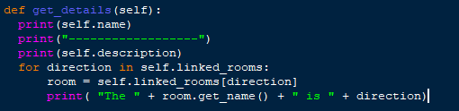
Room.py
SOLUTION

Slide 12

Room.py
Movement

Slide 13
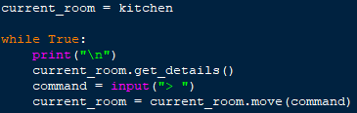
Main.py

Slide 14
Item.py
Don’t forget to test your Item class by creating an Item object and then calling the methods.
The Item class should have the following:
Attributes for the name and the description of the item
Getters and setters for the name and the description of the item
Any additional attributes and methods you would like to add

